Slide 1

Month End Results – Highland Hospital
April 2026

Slide 2
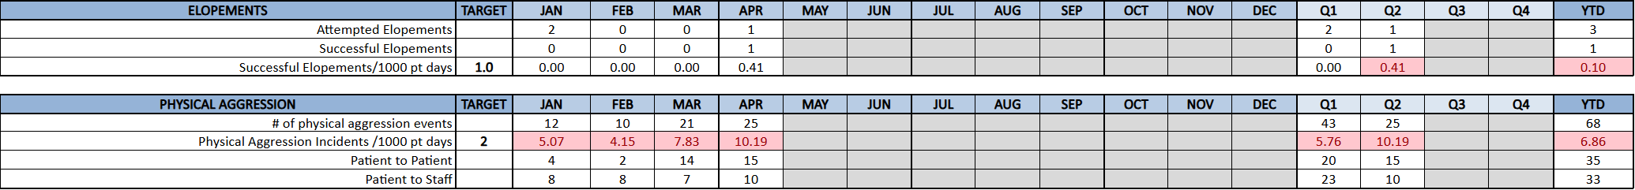
April 2026 – Quality Dashboard – Highland
We saw increases in overall satisfaction, the safety and security score, patient involvement in treatment planning/goals, and the NPS score. Survey return rate declined by 2%, primarily due to AMAs and refusals.
The elopement incident occurred during intake. The patient’s mother called 911 and then removed her child against medical advice from intake.
Physical aggression rose compared to the prior month, largely driven by chronic patients. In response, any patient exhibiting aggression requiring restraint or seclusion is now placed on an immediate behavior support plan.
AMAs and ATDs decreased compared to the prior month.

Slide 3
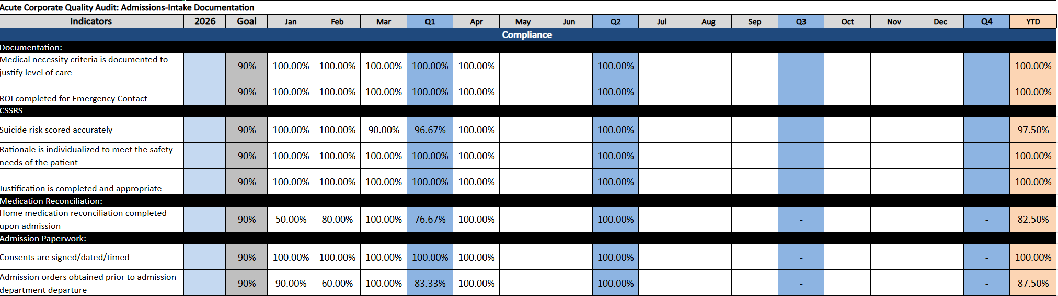
April 2026 – Quality Dashboard – Highland
All indicators improved to 100% compliance in April. This is a result of continued education and follow-up with staff.

Slide 4
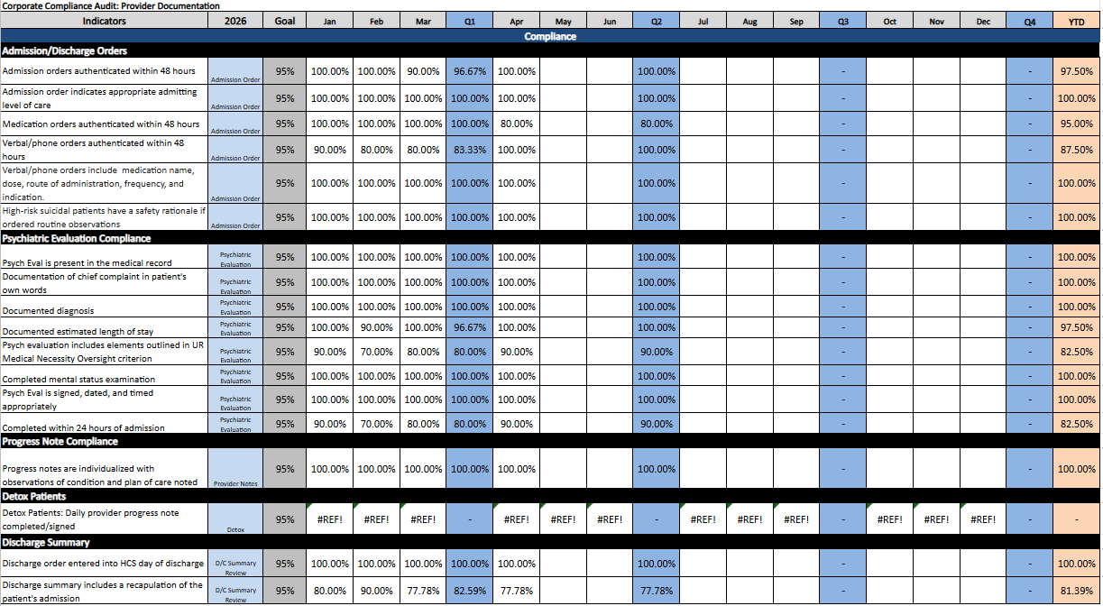
April 2026 – Quality Dashboard – Highland
Compliance remained strong overall, with most indicators meeting or exceeding the 95% target. In April, all metrics achieved 100% except for medication orders authenticated within 48 hours (80%), psychiatric evaluations including the elements outlined in UR medical necessity oversight criteria (90%), and discharge summaries that include a recap of the patient’s admission (77.78%).
Ongoing improvement efforts will focus on routine audits and sharing findings in meetings to strengthen accountability, track progress, and ensure sustained compliance. Provider trainings were also conducted in April to reinforce documentation standards and support improvement in these areas.

Slide 5
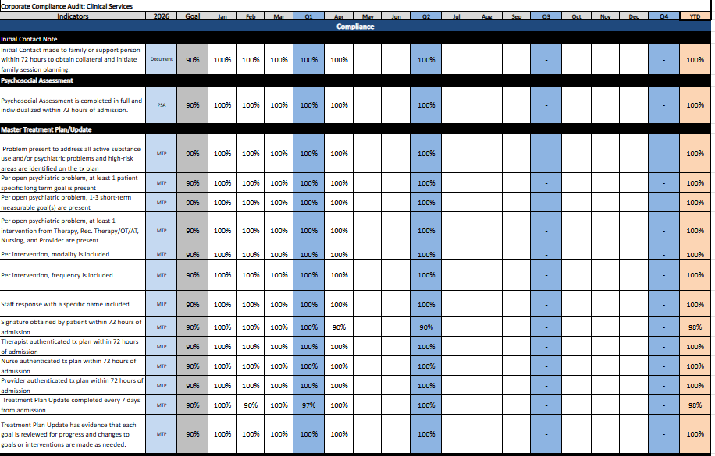
April 2026 – Quality Dashboard – Highland
All metrics achieved 100% compliance, except for obtaining the patient’s signature within 72 hours of admission. In this case, the patient refused to sign, and the refusal was not documented in a timely manner.
Overall, these results reflect strong adherence to documentation standards and demonstrate the effectiveness of staff training and re-education efforts over the past several months.

Slide 6
April 2026 – Overview – Highland

Slide 7
April 2026 – Volume – Highland

Slide 8
April 2026 – Volume – Highland
Deflection Reason | Record Count | % of Total Referrals
Program Need, Not Offered | 85 | 19.5%
Clinical – Lacks Acuity | 69 | 15.9%
Medically Unstable | 53 | 12.2%
Closer | 40 | 9.2%
Information Only | 31 | 7.1%
Pt Refused | 26 | 6.0%
Clinical – High Acuity | 26 | 6.0%
Bed Capacity | 26 | 6.0%
Referral Rescinded | 23 | 5.3%
Non‑Emergency Patient: Financial | 19 | 4.4%
No Show | 18 | 4.1%
Clinical – Lacks Acuity (Assessed & Referred OP) | 8 | 1.8%
Staffing Capacity | 7 | 1.6%
Pt Went Elsewhere | 4 | 0.9%
Total Referrals | 435 | 100%
Admissions
Highland experienced an unfavorable budget variance in April of 39 admissions.
Acute admits had an unfavorable variance to budget of 29 and Detox had an unfavorable variance of 10.
Adolescent admissions had a favorable variance of 2 to budget and adult admissions had an unfavorable variance of 31.
Admissions up 28 over April 2025 and child and adolescent admissions up 31 over prior year. YTD admissions are up 139 (16%)
Medicaid admissions are up 154 over prior year.
Acceptance rate 36.1% in April vs. 38.4% for full-year 2025. Bed capacity deflections increased to 26 for April. If those are removed the acceptance rate jumps to 39.7% for the month.

Slide 9
April 2026 – Volume – Highland
ADC
ADC had an unfavorable variance to budget of 10.0. Acute ADC had an unfavorable variance to budget of 8.6.
Detox had an unfavorable variance to budget of 1.5.
Adult ADC had a favorable variance of 4.1 and C/A had a 4.4 unfavorable variance.
OP Visits
N/A
LOS
ALOS of 10.4 days was 0.4 days favorable to the 10.0 budget.
ALOS was down 3.9 days to prior year due to fewer long term chronic patients and closure of PRTF.
ADC numbers are down, but admission have increased 16% over prior year.
Payor Mix
Medicaid mix of 71% should drive up DPP funding.
Qualifies Highland for the $2.29M/month WV Directed Payment Program supplemental — a $27.5M annualized revenue mechanism that is structurally tied to Managed Medicaid volume
Produces a net revenue per patient day of $2,314 that is 8% above the $2,126 budget. Medicare FFS at 6.1%, 4.0% below budget andis a rate headwind; however, at current Medicaid concentration levels the DPP mechanism more than compensates. Protect the Managed Medicaid referral mix as the highest-leverage financial variable in this facility.

Slide 10
April 2026 – Net Revenue – Highland

Slide 11
April 2026 – Net Revenue – Highland
Net Revenue
Net Revenue of $5.91M exceeded the $5.70M budget by $209K favorable.
Net revenue per patient day of $2313.86 vs $1996.92 budget (+15.9%).
IP Gross Revenue of $7.73M vs $9.32M budget — $1.59M unfavorable.
Census of 2,555 patient days vs 2,856 budget (-301 days).
One-time favorable bad debt adjustment was the main factor for exceeding our net revenue budget.
Denials
In April, we experienced an unfavorable variance of $4,226.
There was a total of 45 denied days(22 accts), of which ABH issued 40 days (19 accts).
The UR PI meetings are in progress. We have conducted retraining sessions with all disciplines and are working to improve the documentation process.
Additionally, we have held meetings with ABH to develop mutually beneficial contracts to strengthen our relationship with this payer.
Our total recoveries for April amounted to $33,433
Charity
Charity adjustments were ($53K) unfavorable to budget. There were 18 patients that totaled 151 patient days for an average of 8.4 days per patient.
The amount booked in April has charity write-offs for Feb, March and April. Actual Charity expense includes this catch up entry.
Admin Adjustments
There were no admin adjustments in the period.
Bad Debt
Total Bad Debt of ($401,554) was $593K favorable to budget.

Slide 12
April 2026 – Expense – Highland

Slide 13
April 2026 – Expense – Highland
Salaries, Wages, and Benefits
Salaries & Wages $1.17M actual vs $1.31M budget — $136K favorable (+10%).
PPD: $459.20 actual vs $512.49 budget.
YTD: $4.70M actual vs $4.85M budget — $148K favorable.
Our paid EPOB is 1% under budget.
We continue for flex down well with a direct care EPOB of
Purchased Services
Purchased Services $157K actual vs $169K budget — $12K favorable (+7%).
We continue to monitor this category for expense management opportunities.
Pro Fees:
Professional Fees $99K actual vs $72K budget — $27K unfavorable (-38%).
We are down one nurse practitioner and are filling this gap with a PRN. We are actively recruiting to fill this position.
Supplies
Supplies $87K actual vs $106K budget — $19K favorable (+18%).
PPD: $34.06 actual vs $41.33 budget.
YTD: $307K actual vs $412K budget — $104K favorable.
Other Expense
Repairs & Maintenance $23K actual vs $35K budget — $12K favorable (+34%).
Other Operating $39K actual vs $37K budget — $2K unfavorable (-5%).

Slide 14
April 2026 – Human Resources – Highland
Turnover:
April monthly turnover was 4.12% (annualized ~69.27%). YTD turnover is elevated due to a recalculation that now includes FT/PT employees who transitioned to PRN, which were not previously counted.
Involuntary terminations have decreased and projected 90-day turnover is expected to be approximately 23% lower than last year. This improvement is attributed to increased leadership involvement in the interview and selection process.
Open Positions:
RN vacancies have decreased, with several critical night-shift positions now filled. As new hires completed onboarding and training, overtime and incentive utilization is expected to decline.
The wage competitiveness analysis for intake, therapy, dietary, and housekeeping is complete, and is currently being reviewed by corporate.
The CL position has been filled, with the new hire starting on May 4, 2026. She brings strong connections in the central and northern regions of WV and is expected to make a positive and immediate impact.
Patient Account Rep position has been filled, and candidate will start in next few weeks.
Recruitment for staff on step-down unit has begun.
Recruitment
HRD and CNO invited to serve on the West Virginia State University Nursing Advisory Board, contributing to discussions on recruitment needs and long-term workforce development for nursing students.
HRD met with the new POC for WV Workforce Now and is currently evaluating upcoming events for Highland's participation.
Physician Recruitment:
Dr. Shick’s acceptance is a significant win. She is a returning child psychiatrist with established facility relationships. Anticipated start is July.
On-site child/adolescent psychiatric coverage directly supports the C/A volume strategy and DPP optimization.
Additional interview scheduled wth NP with strong psych experience.

Slide 15
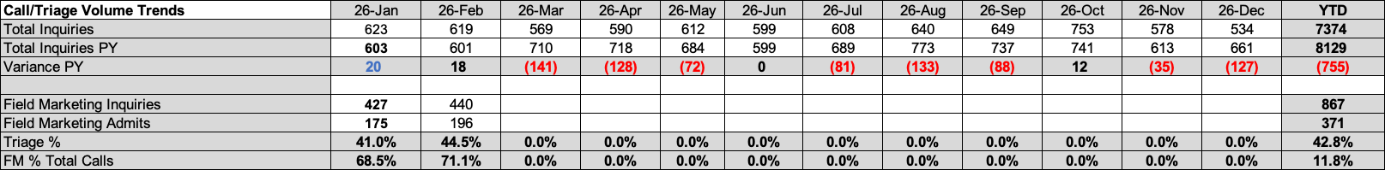
April 2026 – Business Development – Highland Hospital
Call/Triage Volume Trends | 26-Jan | 26-Feb | 26-Mar | 26-Apr | 25-May | 25-Jun | 25-Jul | 25-Aug | 25-Sep | 25-Oct | 25-Nov | 25-Dec | YTD
Total Inquiries | 623 | 619 | 713 | 678 | 612 | 599 | 608 | 640 | 649 | 753 | 578 | 534 | 7518
Total Inquiries PY | 603 | 601 | 619 | 590 | 684 | 599 | 689 | 773 | 737 | 741 | 613 | 661 | 8038
Variance PY | 20 | 18 | 94 | 88 | (72) | 0 | (81) | (133) | (88) | 12 | (35) | (127) | (520)
Field Marketing Inquiries | 427 | 440 | 501 | 467 |  |  |  |  |  |  |  |  | 1368
Field Marketing Admits | 175 | 196 | 182 | 172 |  |  |  |  |  |  |  |  | 553
Triage % | 41.0% | 44.5% | 36.3% | 0.0% | 0.0% | 0.0% | 0.0% | 0.0% | 0.0% | 0.0% | 0.0% | 0.0% | 40.4%
FM % Total Calls | 68.5% | 71.1% | 70.3% | 0.0% | 0.0% | 0.0% | 0.0% | 0.0% | 0.0% | 0.0% | 0.0% | 0.0% | 18.2%
BD Staffing Coverage:
CL position has been filled with start date of 5/4/26
External and Internal Factors Impacting Volume:
Continuing rolling county Spring breaks through April 20th.
Prior Month & Prior Year Comparison:
678 Total inquiries: -35 PM; +88 PY
467 Field inquiries: -34 PM; +67 PY
245 Total admissions: -14 PM; +5 PY
Conversion 36%; consistent with prior month
April closed with 678 total inquiries, reflecting a variance of -35 versus prior month and +88 versus prior year. Of the total, 467 inquiries were generated from field activity, representing -34 versus prior month and +67 versus prior year.
Total admissions finished at 245 reflecting -14 versus prior month and +5 versus prior year, while conversion was at 36 percent remaining consistent with prior month.

Slide 16
April 2026 – Business Development – Highland Hospital
Field Marketing Productivity - Current Month | Face-to-Face (Scheduled) |  | Face-to-Face (Unscheduled) |  | Phone Contacts |  | Group Contacts (3 or More) |  | Misc. Contacts (Emails, Texts, Tours, Zoom Calls) |  | Total Contacts |  | Total Inquiries | Current Month Admits
Brenda Wylie | 0 |  | 119 |  |  |  | 4 |  | 134 |  | 257 |  | 117 | 117
Arron Walker | 11 |  | 126 |  | 7 |  | 3 |  | 25 |  | 172 |  | 2 | 2
Other |  |  |  |  |  |  |  |  |  |  |  |  | 330 | 53
Total | 11 |  | 245 |  | 7 |  | 7 |  | 159 |  | 429 |  | 449 | 172
Field Marketing Admit Productivity
YTD Trend | 26-Jan | Feb | Mar | Apr | May | June | July | Aug | Sept | Oct | Nov | Dec | YTD
 |  |  |  |  |  |  |  |  |  |  |  |  | 0.0
Brenda Wylie | 4.0 | 22.0 | 50.0 | 117.00 |  |  |  |  |  |  |  |  | 76.0
Arron Walker |  | 2.0 | 1.0 | 2.0 |  |  |  |  |  |  |  |  | 3.0
OTHER | 171.0 | 146.0 | 131.0 | 53.00 |  |  |  |  |  |  |  |  | 448.0
Total | 175.0 | 170.0 | 182.0 | 172.0 | 0.0 | 0.0 | 0.0 | 0.0 | 0.0 | 0.0 | 0.0 | 0.0 | 527.0
Data Integrity / Staffing: • Salesforce data and referral accounts will be reallocated to the new CL’s and DBD to ensure accurate reporting and territory alignment. • Second CL position has been filled.
Other Ongoing Initiatives
Attempting to schedule a meeting to finalize contract for state hospital stepdown program.
4th floor construction to begin in late June.

Slide 17
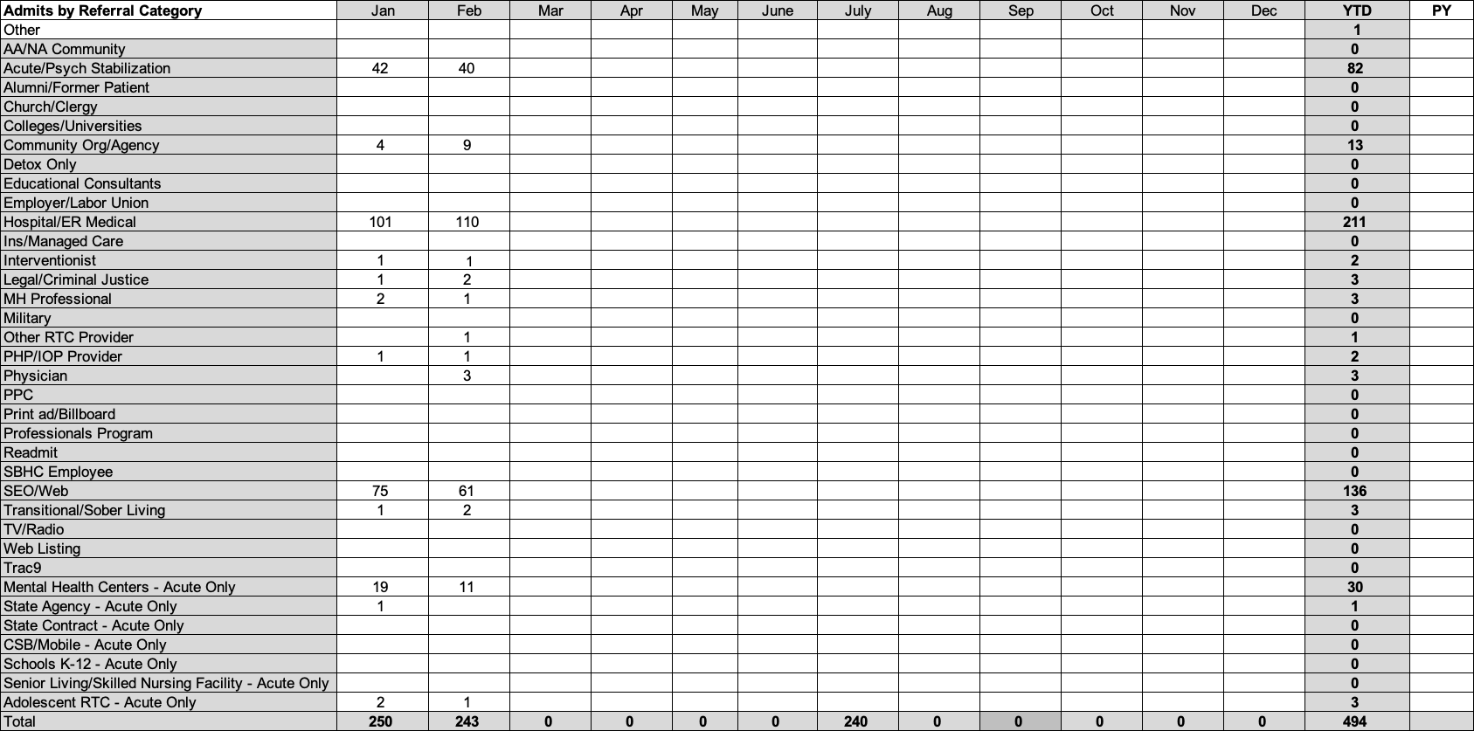
April 2026 – Business Development – Highland Hospital
Admits by Referral Category | Jan | Feb | Mar | Apr | May | June | July | Aug | Sep | Oct | Nov | Dec | YTD
Other |  |  |  |  |  |  |  |  |  |  |  |  | 1
AA/NA Community |  |  |  |  |  |  |  |  |  |  |  |  | 0
Acute/Psych Stabilization | 42 | 40 | 44 | 42 |  |  |  |  |  |  |  |  | 126
Alumni/Former Patient |  |  |  |  |  |  |  |  |  |  |  |  | 0
Church/Clergy |  |  |  |  |  |  |  |  |  |  |  |  | 0
Colleges/Universities |  |  |  |  |  |  |  |  |  |  |  |  | 0
Community Org/Agency | 4 | 9 | 11 | 7 |  |  |  |  |  |  |  |  | 24
Detox Only |  |  |  |  |  |  |  |  |  |  |  |  | 0
Educational Consultants |  |  |  |  |  |  |  |  |  |  |  |  | 0
Employer/Labor Union |  |  | 1 |  |  |  |  |  |  |  |  |  | 1
Hospital/ER Medical | 101 | 110 | 106 | 105 |  |  |  |  |  |  |  |  | 317
Ins/Managed Care |  |  |  |  |  |  |  |  |  |  |  |  | 0
Interventionist | 1 | 1 |  |  |  |  |  |  |  |  |  |  | 2
Legal/Criminal Justice | 1 | 2 | 1 | 1 |  |  |  |  |  |  |  |  | 4
MH Professional | 2 | 1 | 1 | 2 |  |  |  |  |  |  |  |  | 4
Military |  |  |  |  |  |  |  |  |  |  |  |  | 0
Other RTC Provider |  | 1 | 1 | 1 |  |  |  |  |  |  |  |  | 2
PHP/IOP Provider | 1 | 1 | 1 |  |  |  |  |  |  |  |  |  | 3
Physician |  | 3 | 2 | 1 |  |  |  |  |  |  |  |  | 5
PPC |  |  |  |  |  |  |  |  |  |  |  |  | 0
Print ad/Billboard |  |  |  |  |  |  |  |  |  |  |  |  | 0
Professionals Program |  |  |  |  |  |  |  |  |  |  |  |  | 0
Readmit |  |  |  |  |  |  |  |  |  |  |  |  | 0
SBHC Employee |  |  |  |  |  |  |  |  |  |  |  |  | 0
SEO/Web | 75 | 61 | 64 | 73 |  |  |  |  |  |  |  |  | 200
Transitional/Sober Living | 1 | 2 |  |  |  |  |  |  |  |  |  |  | 3
TV/Radio |  |  |  |  |  |  |  |  |  |  |  |  | 0
Web Listing |  |  |  |  |  |  |  |  |  |  |  |  | 0
Trac9 |  |  |  |  |  |  |  |  |  |  |  |  | 0
Mental Health Centers - Acute Only | 19 | 11 | 19 | 10 |  |  |  |  |  |  |  |  | 49
State Agency - Acute Only | 1 |  | 1 | 1 |  |  |  |  |  |  |  |  | 2
State Contract - Acute Only |  |  |  |  |  |  |  |  |  |  |  |  | 0
CSB/Mobile - Acute Only |  |  |  |  |  |  |  |  |  |  |  |  | 0
Schools K-12 - Acute Only |  |  | 4 |  |  |  |  |  |  |  |  |  | 4
Senior Living/Skilled Nursing Facility - Acute Only |  |  |  |  |  |  |  |  |  |  |  |  | 0
Adolescent RTC - Acute Only | 2 | 1 | 3 | 2 |  |  |  |  |  |  |  |  | 6
Total | 250 | 243 | 259 | 245 | 0 | 0 | 0 | 0 | 0 | 0 | 0 | 0 | 753

Slide 18
April 2026 – Business Development – Highland Hospital
Service Line
Detox inquiries increased decreased from prior month and prior year, -33 PM; -11 PY
Adol inquiries increased over prior month and prior year, +9 PM; +58 PY
Adult inquiries decreased from prior month and increased over prior year, -12PM; +46 PY
• Continued focus on Highland Recovery Center (HRC) service line with targeted outreach leveraging established contacts and expertise continues, awaiting expansion to 3.5 services. • Focus on Adult accounts is a priority for BD team.
Account Type
Top 3: HER (332) -7 PM; Acute Psych (80) +8 PM; Mental Health Centers (18) -19 PM
Bottom 3: PHP/IOP Providers (1) <2> PM; Physicians (1) <3> PM; Other RTC Providers (4) +3 PM
• Focus on private providers and residential treatment centers have increased. .
Account Type – v PM
Declines were seen from CAMC W&C <3>; Princeton Community Hospital <5>; Logan <5>; Davis <6>; and Help4WV <2>.
Growth was seen from Bateman +4; CAMC General +18; Berkeley Medical Center +5; Grant +3; and Potomac +7.
Other Areas Impacting Growth • Rolling Spring break schedules continue across counties in WV (March 9–April 20). • Daily bed availability email blasts continue, increasing to twice daily when census requires, including weekend distribution. • Monthly service line marketing campaigns continue – April/May focus on adult services.
PMO / Strategic Focus • BD team meets weekly with CEO to review strategy, initiatives, and expectations. • Recovery Plan and Summer Break Plan developed and implemented.
Marketing / Outreach • Ongoing email blasts promoting service lines and bed availability- focus for April is adult services. • Will have exhibit at WV Primary Care Association Conference in June to expand provider engagement statewide and School Summit in July.
• Held educational presentation with 30 providers of Family Care Health Centers April 1st providing increased awareness of Highland array of services and referral process
New Business / Partnerships • Evaluating opportunities to exhibit at additional conferences to expand outreach to primary care, behavioral health providers, and school-based health networks.
Major Events / Conferences • Share the Vision (WV First Foundation/Community Connections) April 14-16, Huntington, WV • WV Licensed Professional Counselors Association Conference, April 16-17, Stonewall Jackson, Roanoke, WV
Negotiations continuing for addition of 3.5 services in HRC.

